Slide 1
Freebies for Newbies
A place to find free event and items
Client & Mentor:
Dr. Chandra Mouli Kotteti
Team Members:
Manoj Kumar Gude
Harish Chowdary Bala
Saibabu Devarapalli
Jaichand Mulakalapalli
Aditya Krishna Raavi
05

Slide 2
MEET OUR TEAM
JAICHAND MULAKALAPALLI
(TEAM LEADER) BACKEND
MANOJ KUMAR GUDE
FRONTEND
ADITHYA KRISHNA RAAVI
FRONTEND
Saibabu devarapalli
Fullstack
HARISH CHOWDARY BALA
DATABASE
DR. CHANDRA MOULI KOTTETI
Mentor & Client

Slide 3
AGENDA
Introduction
Session Timeout in Android Devices
Android Testing
Header Layout in Navigation View
Header Layout Implementation
Security Risks and Cryptography
Menu in Navigation view
Summary
Session Timeout Implementation

Slide 4
Introduction
Freebies for Newbies is an android application, which helps international students to access to free items and events in the desired location.Tools and Design:
● Android Studio - The tool used for the UI development.
● GenyMotion - Emulator (Virtual device).
● Git Hub - To integrate UI part and store it.
● Oracle VirtualBox - Its an essential tool required to run for GenyMotion.
● Back4App – Database.
● Testing - Junit + Mokito.

Slide 5
Header Layout in Navigation View
The header layout in navigation view is an important element of any android app that requires users to log in.
It provides quick access to account information and settings.
It provides a consistent look and feel across different screens and platforms.
It helps users identify where they are in the app.

Slide 6
Header Layout Implementation
Inside the NavigationView element, add a LinearLayout or any other layout element that you want to use as the header layout.
app:headerLayout="@layout/header_layout“
In your activity or fragment, initialize the NavigationView using findViewById() method. Call the getHeaderView() method on the NavigationView object to get a reference to the header layout.

Slide 7
Header Layout Implementation
NavigationView navigationView = findViewById(R.id.navigation_view);
View headerView = navigationView.getHeaderView(0);
TextView nameTextView = headerView.findViewById(R.id.text_view_name);
ImageView profileImageView = headerView.findViewById(R.id.image_view_profile);
nameTextView.setText("John Doe");
profileImageView.setImageResource(R.drawable.profile_image);

Slide 8
Security RISKS
Android is precisely the most widely used operating system in the world (at least 80% of mobile devices run on it). This makes it the main target for hackers and cyber-attacks.
In android there are six security risks identified by the developers. They are:
Malware and malicious software
Android fragmentation
Customized operating systems
App downloads outside the store
Infiltration of malicious apps in the store
Vulnerable software for mobile application development

Slide 9
BEST PRACTICES to overcome security risks
The Best Practices to overcome security are defined as:
Architecture design and threat modeling
Data storage and privacy
Cryptography
Platform interaction
Code quality and build setting

Slide 10
cryptography
Cryptography is the practice of protecting information through the use of coded algorithms, hashes, and signatures.
The primary goals of cryptography are
Confidentiality – Makes information available to only authorized users.
Integrity – Ensures that information has not been manipulated.
Authentication – Confirms the authenticity of the information or the identity of a user.
Non-repudiation – Prevents a user from denying prior commitments or actions.
Here we are using a cipher algorithm by cryptography to main the security between the database and application.

Slide 11
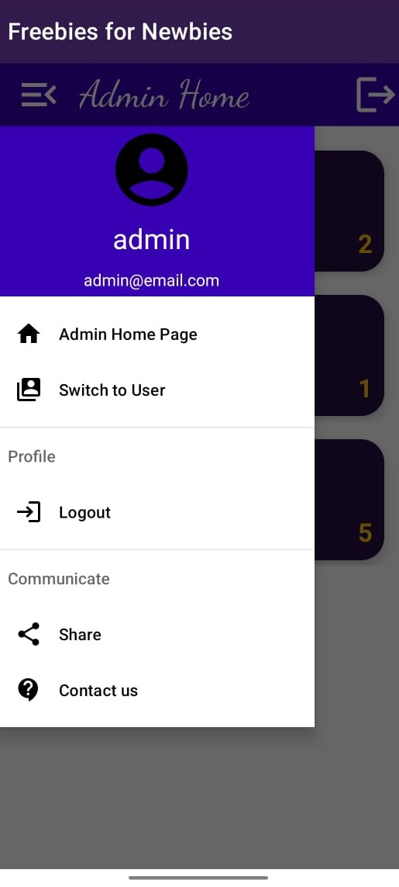
Menu in navigation view
Navigation Menu which has mainly header and menu. Header contains some images with background menu contains three blocks like Home, profile, communicate such as share and Contact us.
Menu: In Android, a menu is a collection of options or actions that can be performed in an application. Menus can be displayed in different ways, such as a pop-up menu, a floating context menu, or a navigation drawer menu. A menu can contain one or more menu items.
Menu Items: A menu item represents a single option or action in a menu. Each menu item has an ID that can be used to identify the item and respond to user actions. A menu item can have various attributes, such as a title, an icon, a shortcut key, or a checkable state.

Slide 12
Menu in navigation view
The reason why we should define menu in menu resource:
The first and most important thing it separates from our activity, so visualization and debugging is easy.
Separating the menu gives us flexibility like for different platform versions, screen sizes we can make some changes to our menu resource file.
Easy to manage as it’s separate from our activity.
Setting Visibility: In Android, you can set the visibility of a menu item to control when it should be displayed or hidden.
There are three visibility states:
visible: the item is visible
invisible: the item is hidden, but takes up space in the menu
gone: the item is hidden, and does not take up space in the menu
We must use Drawer layout instead scroll view for navigation view.

Slide 13
Menu in navigation view
Java code:
// Get a reference to the menu item
MenuItem myMenuItem = menu.findItem(R.id.my_menu_item);
// Set the visibility of the menu item
myMenuItem.setVisible(false); // hide the item
myMenuItem.setVisible(true); // show the item
You can also set the visibility of a menu item using XML attributes. For example, to hide a menu item in the XML layout file, you can add the android:visible="false" attribute to the menu item element.
Xml code:
<menu xmlns:android="http://schemas.android.com/apk/res/android">
<item
android:id="@+id/my_menu_item"
android:title="My Menu Item"
android:visible="false" /> <!-- hide the item -->

Slide 14
Android testing
It is a process of testing GUI Interface in Android applications. The goal is to meet the functional requirements of the user. It’s a critical part in the UI Testing.
Google Test Framework allows you to test user interface Of our native Android apps on one or more devices. Another advantage of the UI Automator is it runs Junit test cases with special privileges which means test cases can span across different processes.
They are 3 types of testing in Android
Unit Tests This is a small piece of Business logics Actually there would be thousand of such logics in the UI which should run in the milli seconds
They should work for every Git push and Git Merge.
Technologies Junit + Mokito.
Component /Functional /Integration Tests Usually focuses on UI/Ux screen time .It is used for android deep linking testing which has unique behavior.

Slide 15
ANDROID TESTING
It is a process of testing GUI Interface in Android applications. The goal is to meet the functional requirements of the user. It’s a critical part in the UI Testing.
Google Test Framework allows you to test user interface Of our native Android apps on one or more devices. Another advantage of the UI Automator is it runs Junit test cases with special privileges which means test cases can span across different processes.
They are 3 types of testing in Android
Unit Tests This is a small piece of Business logics Actually there would be thousand of such logics in the UI which should run in the milli seconds
They should work for every Git push and Git Merge.
Technologies Junit + Mokito.
Component /Functional /Integration Tests Usually focuses on UI/Ux screen time .It is used for android deep linking testing which has unique behavior.

Slide 16
ANDROID TESTING IN MOBILE DEVICES
Enable USB Debugging in Android Phone
Connect Phone to PC
Install Phone USB Devices
Run App on Phone.
Go the settings ->Click on Build Number for 7 times -> Insert Password .
Go back -> Developer Options -> USB Debugging Enable
Connect the Phone to PC-> USB Connected -> USB Debugging On.
GO to Device Manager->Select Device-> Select First option on the screen -> Go to Huwei installer ->Android device run the app ->SDK Manger-> Selecting the device

Slide 17
Session Time Out in Android Studio
Session timeout is an important feature in Android apps that automatically logs users out after a period of inactivity.
It improves app security and protects user privacy.
It helps prevent unauthorized access to user accounts and ensures that users are logged out of the app when they are not actively using it.
It helps freeing up resources and improving performance.

Slide 18
Session Time Out Implementation
Create a timer and a boolean flag(isUserActive) to keep track of the user's activity status.
In the onUserInteraction() method, reset the timer and set the isUserActive flag to true.
Implement the resetInactivityTimer() method, which cancels any existing timer and starts a new one.
Implement the logoutUserAndReturnToLogin() method, which logs out the user and returns to the login page.
In the onResume() override method, start the inactivity timer if the isUserActive flag is true.
In the onPause() override method, cancel the inactivity timer and set the isUserActive flag to false.

Slide 19
SUMMARY
In conclusion, both the header layout in navigation view and session timeout are important features of any Android app that requires users to log in.
By following best practices and designing these features with user experience and security in mind, you can create a better overall experience for your users.

Slide 20

Any Questions?

Slide 21


Slide 22
MEET OUR TEAM
JAICHAND MULAKALAPALLI
(TEAM LEADER) BACKEND
MANOJ KUMAR GUDE
FRONTEND
ADITHYA KRISHNA RAAVI
FRONTEND
Saibabu devarapalli
Fullstack
HARISH CHOWDARY BALA
DATABASE
DR. CHANDRA MOULI KOTTETI
Mentor & Client

Slide 23
Freebies for Newbies
A place to find free event and items
Client & Mentor:
Dr. Chandra Mouli Kotteti
Team Members:
Manoj Kumar Gude
Harish Chowdary Bala
Saibabu Devarapalli
Jaichand Mulakalapalli
Aditya Krishna Raavi
05

